Slide 1
Basic EMTG Tutorial
Jacob Englander
4-21-2020

Slide 2
Some nuts and bolts
EMTG is available open-source at https://sourceforge.net/projects/emtg/
EMTG is written in C++ and the user interface, PyEMTG, is written in Python 3
EMTG is script-driven; all PyEMTG does is write scripts and read output files
To compile EMTG, one also needs the Boost C++ extensions, the CSPICE ephemeris library, the Gnu Scientific Library (GSL), Randutils, and most importantly SNOPT.
PyEMTG depends on wxPython
EMTG is happily cross-platform and is used operationally on OSX, Windows, and Linux.
We have provided Windows build documentation. The list of required packages is the same on Linux and OSX, and the build system will work on all three.

Slide 3
Let’s play with EMTG…
Today we are going to design two missions in EMTG
OSIRIS-REx
A New Frontiers class mission to acquire a sample from near-Earth asteroid Bennu and return it to Earth
LowSIRIS-REx
Academic problem which is very similar to OSIRIS-REx but uses low-thrust electric propulsion
In the next several slides, we will walk you through how to create these missions in EMTG
Start your PyEMTG…

Slide 4
Configuring PyEMTG
Edit your PyEMTG.options to ensure that PyEMTG has paths to:
EMTG executable
Universe folder (where all ephemeris-related things live)
Hardware models folder and power/propulsion/launch vehicle files
Your small bodies file (optional file for searching for targets of opportunity)
EMTG_path C:/EMTG_open_source/emtg/bin/EMTGv9.exe
default_universe_path C:/EMTG_open_source/OpenSourceData/Universe
de_file de430.bsp
leapseconds_file naif0012.tls
default_small_bodies_file none
default_HardwarePath C:/EMTG_open_source/OpenSourceData/HardwareModels/
default_ThrottleTableFile empty.ThrottleTable
default_LaunchVehicleLibraryFile default.emtg_launchvehicleopt
default_PowerSystemsLibraryFile default.emtg_powersystemsopt
default_PropulsionSystemsLibraryFile default.emtg_propulsionsystemopt
default_SpacecraftOptionsFile default.emtg_spacecraftopt

Slide 5
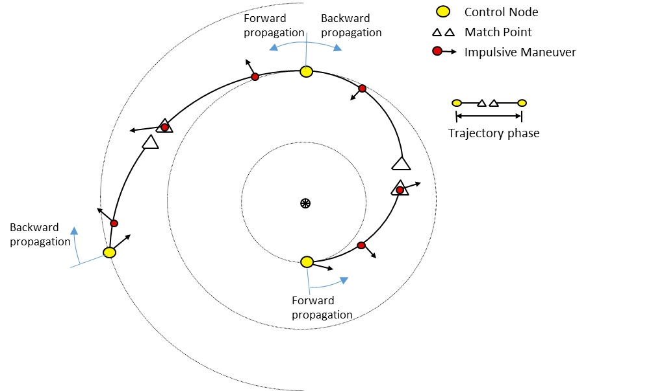
Chemical Mission Modeling in EMTG
M. Vavrina and J. Englander, “Global Optimization Of N-maneuver, High-thrust Trajectories Using Direct Multiple Shooting,” AAS Space Flight Mechanics Meeting, Napa, CA, February 2016.

Slide 6
OSIRIS-REx Step 1a: Acquire body ephemeris data
EMTG is most accurate when a SPICE kernel is provided for each body of interest
You can create a SPICE kernel for any body in the HORIZONS database at: http://ssd.jpl.nasa.gov/x/spk.html
Place SPICE kernels in your ‘EMTG_open_source/OpenSourceData/universe/ephemeris_files/’ directory
Alternatively you may specify Keplerian orbit elements. This results in faster EMTG execution but less accuracy.

Slide 7
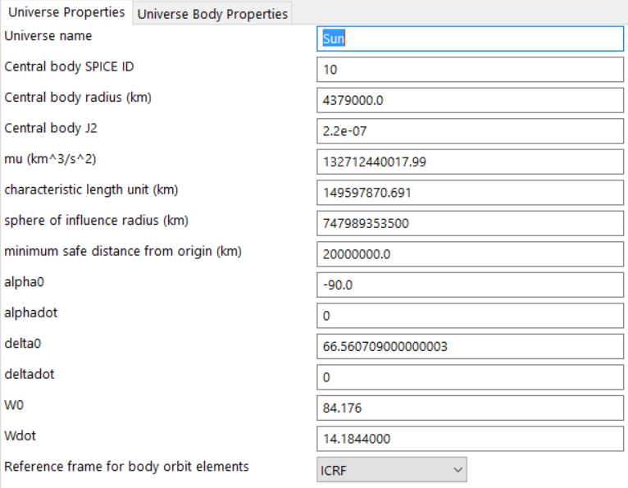
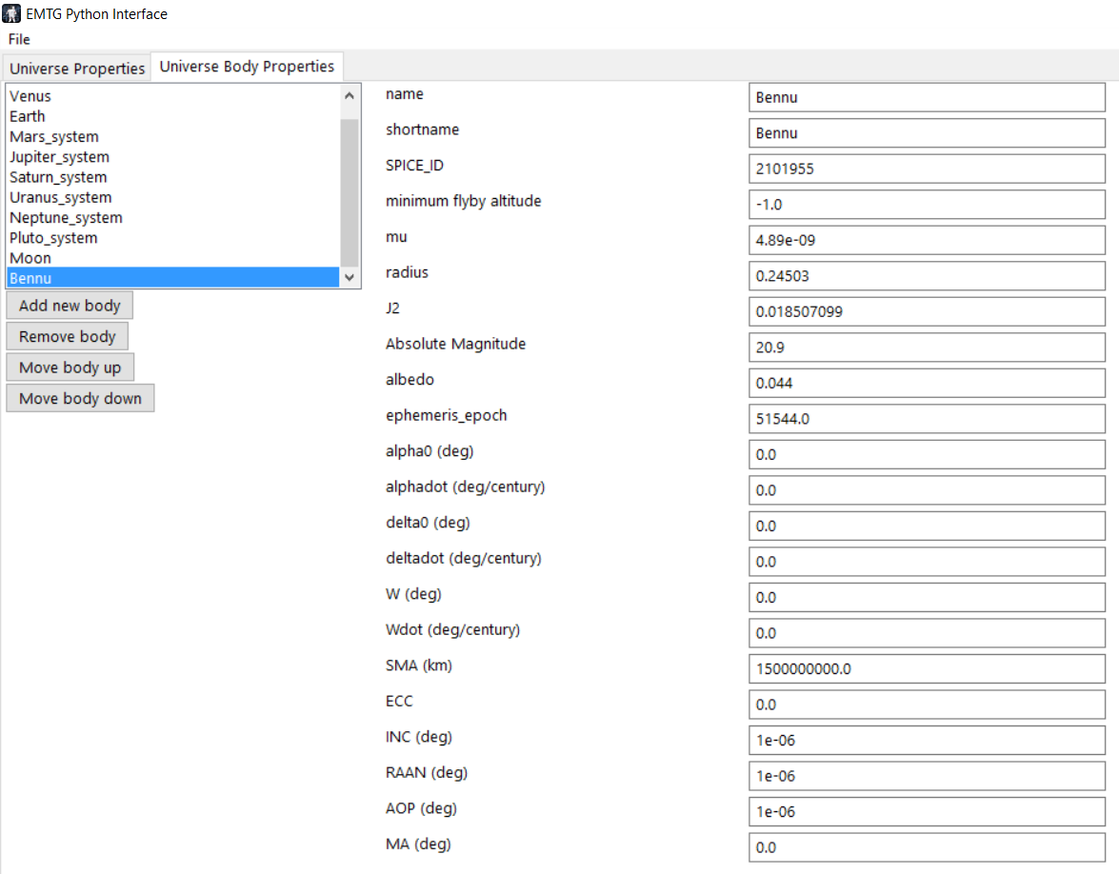
OSIRIS-REx Step 1b: Create a Universe file to teach EMTG about your body(ies)
Users make EMTG aware of a body by putting entering it into a “Universe” file
Every journey in an EMTG mission can have a different Universe file if you so desire but you can use on Universe file for the whole mission.
You can do this in the GUI or edit a .emtg_universe text file directly. Text is easier.
Create a body and tell EMTG your new body’s SPICE ID and name. If you are using SPICE, all you need to enter is name, shortname, and SPICE_ID.

Slide 8
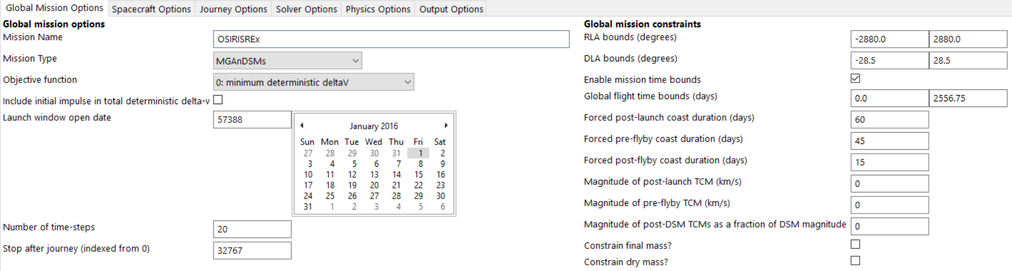
OSIRIS-REx Step 2: The Global Options Tab
Use the MGAnDSMs transcription for chemical missions
There are many objective functions. We’ll use minimum Δv in this example.
PyEMTG does math! You can, for example, write “365.25 * 7” in the flight time bounds field.
For chemical missions, the “number of time-steps” field only affects the resolution of the final trajectory plot and not the solution itself.
It is good policy to set a 60 day coast constraint after launch, and 45 days before and 15 days after each gravity assist.

Slide 9
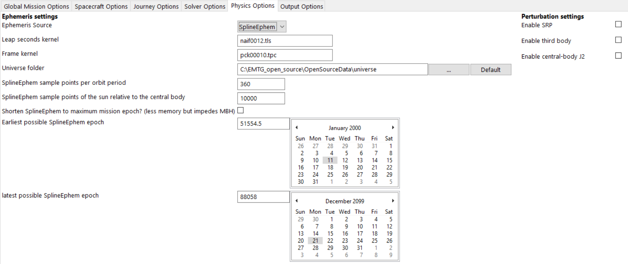
OSIRIS-REx Step 3: The Physics Options Tab
Make sure your script points to the correct Universe folder or else nothing will work. If you configured PyEMTG.options correctly you can just click the “Default” button.
Third body and solar radiation pressure perturbations only work if your propagator is set to “Integrator.” This is very slow and unnecessary for this stage of design.

Slide 10
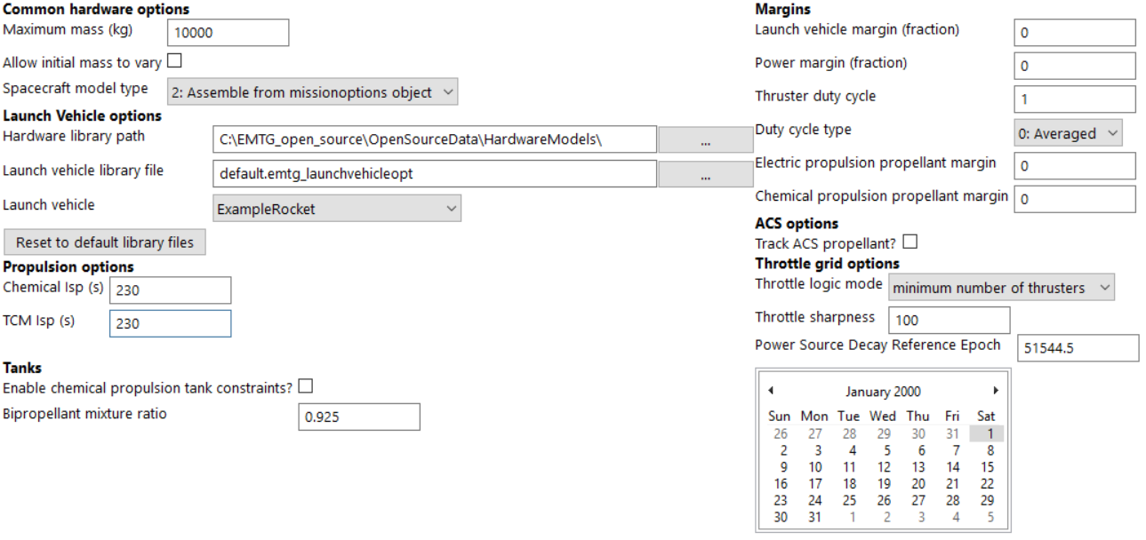
OSIRIS-REx Step 4: The Spacecraft Options Tab
Choose a suitable launch vehicle model and chemical thruster I_{sp} must be chosen. If we were to optimize on mass, EMTG would trade between the thruster and the launch vehicle to deliver the most mass to the target. We are using the example rocket, which is fictitious.
The “maximum mass” field in this case just scales the optimization problem; the actual launch mass is limited to whatever the launch vehicle can carry to the C3 that the optimizer chooses.

Slide 11
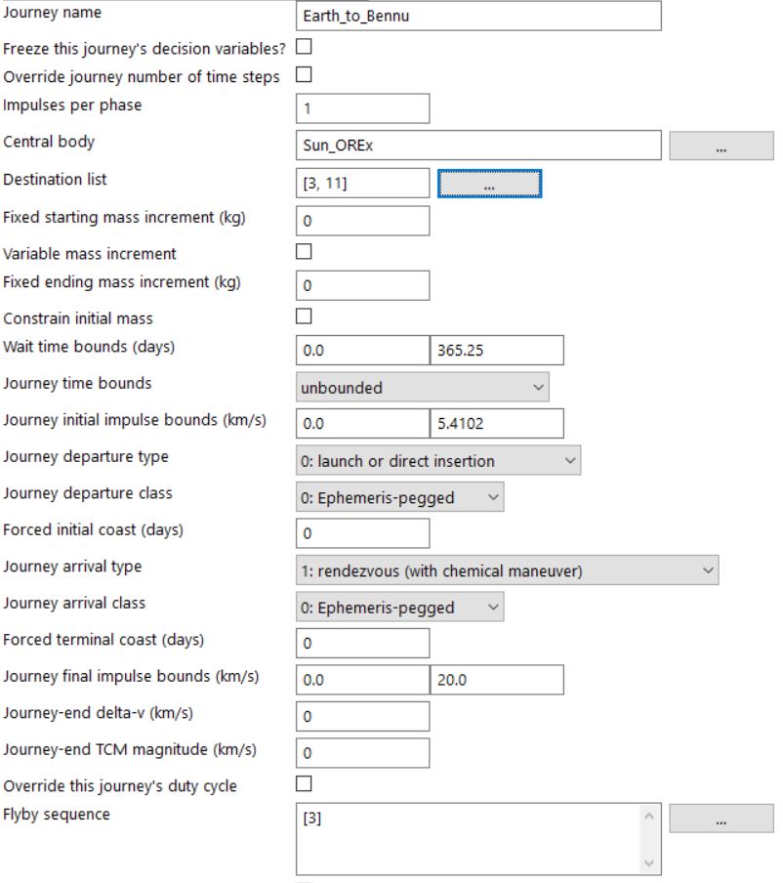
OSIRIS-REx Step 5a: The Journey Options Tab (Journey 1)
Each “journey” represents a set of events with user-defined boundary conditions – in this case launch from Earth and arrival at Bennu.
There are many types of journey departure and arrival conditions. The ones shown here are appropriate for a small body rendezvous.
Each journey can contain any number of phases. If a journey has more than one phase, they are separated by planetary flybys. In this case we have selected an Earth flyby.

Slide 12
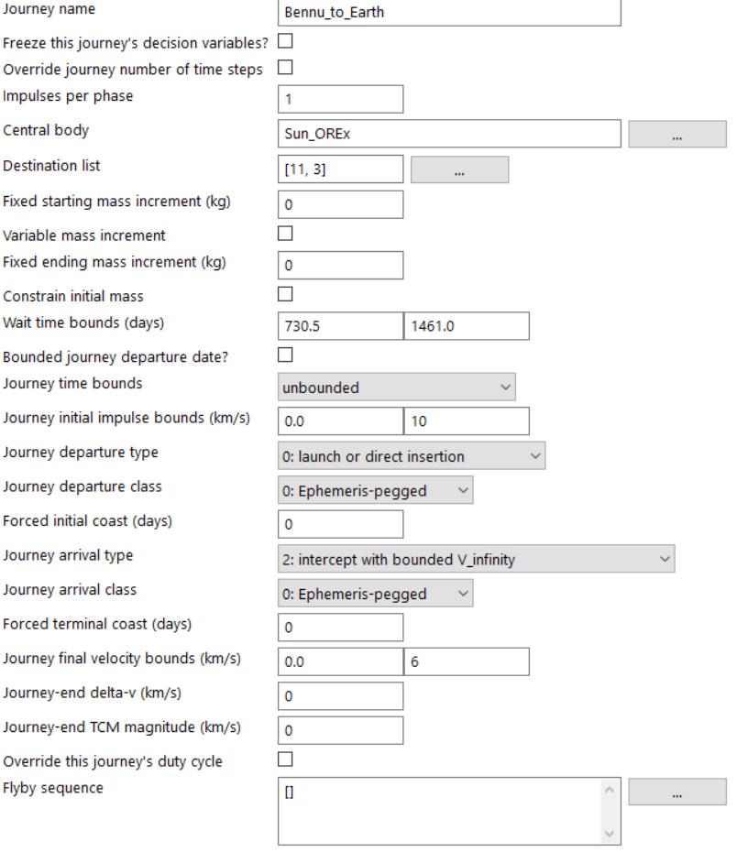
OSIRIS-REx Step 5b: The Journey Options Tab (Journey 2)
We constrain OSIRIS-REx to spend between 2 and 4 years at Bennu.
OSIRIS-REx ends with a landing on Earth.
We are simulating Earth arrival as an intercept with bounded v-infinity.
EMTG is capable of modeling the flight path of OSIRIS-REx from the boundary of Earth’s sphere of influence to its interface with the atmosphere and supports a variety of entry constraints. However this is out of scope for the tutorial. See the scripted constraints document in emtg/docs/constraint_scripting for more details.

Slide 13
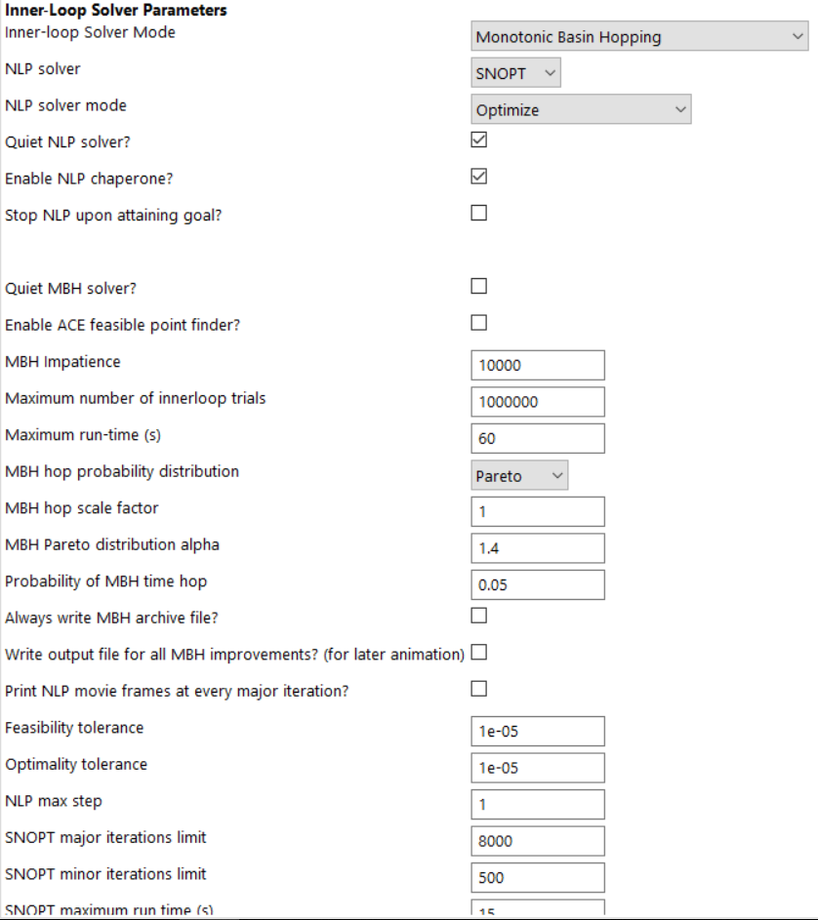
OSIRIS-REx Step 6: The Solver Options Tab
For this example we will use Monotonic Basin Hopping (MBH) with a Pareto distribution. For chemical missions we recommend setting the “Pareto alpha” to 1.4 or, if the problem has many local optima, 1.3.
The ACE feasible point finder allows MBH to compare infeasible solutions and search for minimum infeasibility before it finds its first feasible solution and begins to search for optimality.
The “NLP chaperone” enables EMTG to recover the best solution found in a run of SNOPT even if SNOPT does not converge.

Slide 14
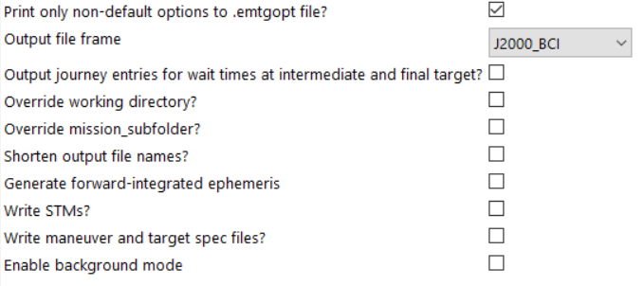
OSIRIS-REx Step 7 The Output Options Tab
We don’t need any of these right now.
For the purpose of this tutorial it is sufficient to know that “background mode” means “close EMTG as soon as it is done executing.” If you are running EMTG from PyEMTG then you should leave background mode off so that you can see your results more easily.
“Print only non-default options to .emtgopt file” means write a short-form .emtgopt that takes up less space on your hard drive.

Slide 15
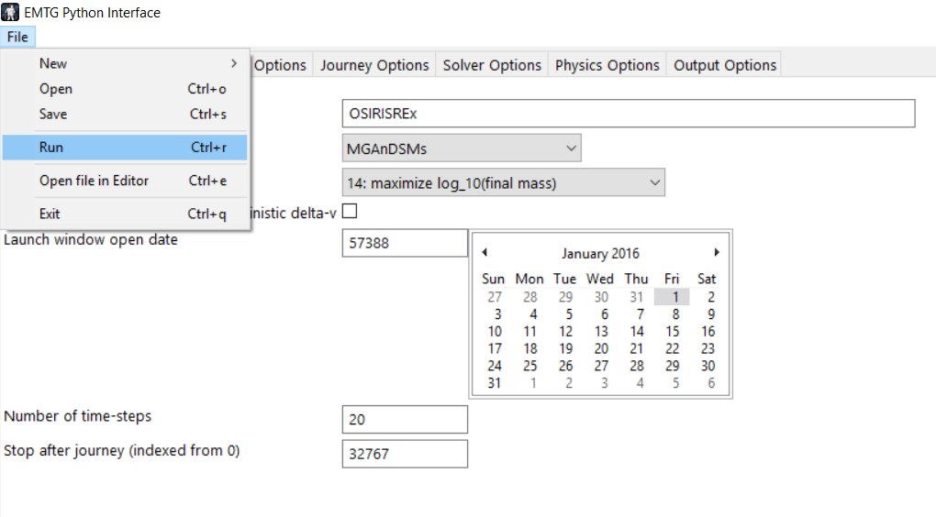
OSIRIS-REx Step 8: Run your mission!
PyEMTG will prompt you to save a “.emtgopt” options file.
EMTG will then execute, create a new timestamped subdirectory for your results, and begin solving your problem.

Slide 16
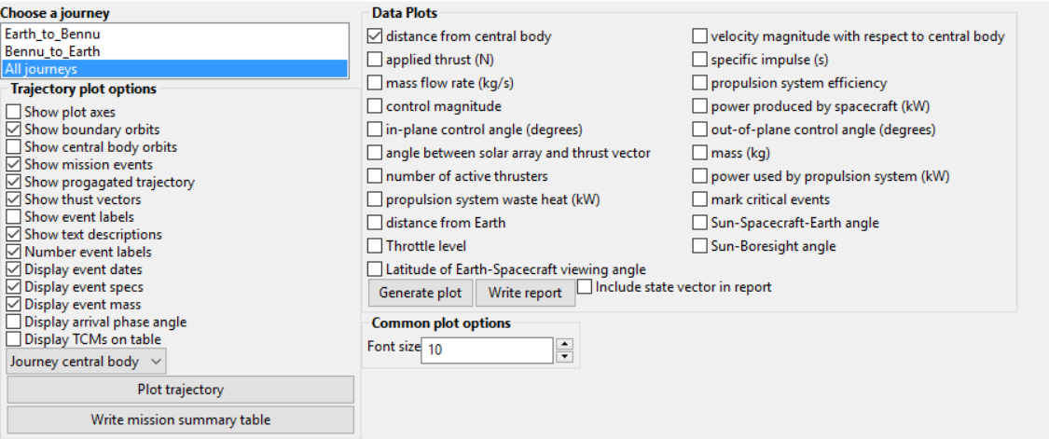
OSIRIS-REx Step 9: Post-Process Your Mission
PyEMTG can open “.emtg” options files.
PyEMTG can create trajectory plots and systems summary plots, and process various other EMTG outputs.
We will focus on the trajectory plot for this example.
PyEMTG can also search for targets of opportunity along your trajectory. This is out of scope for the tutorial.

Slide 17
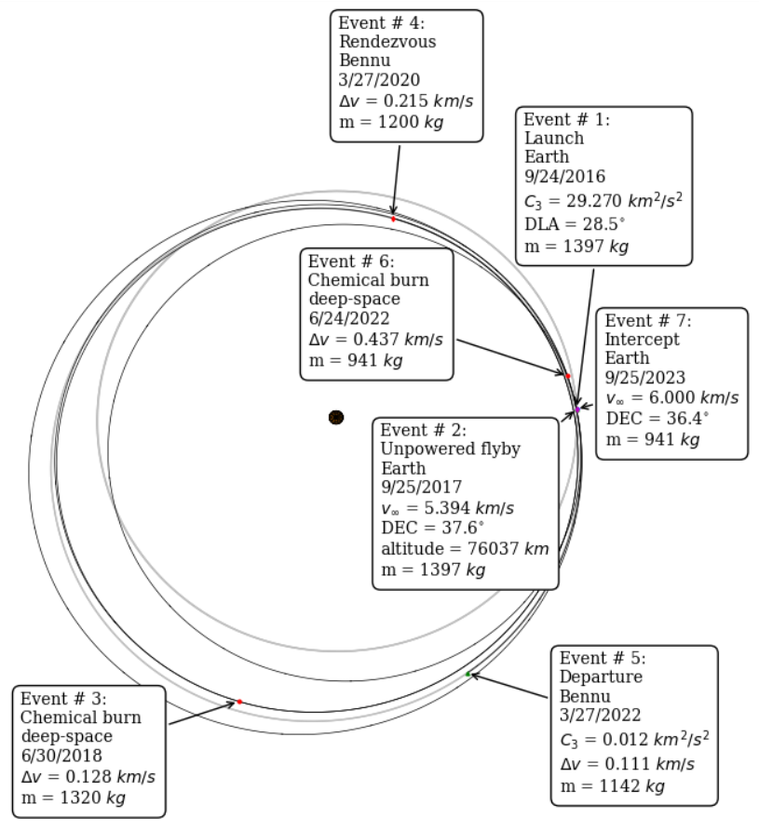
“OSIRIS-REx-like” Trajectory Plot (note: the real mission has other constraints and does not look like this)

Slide 18
Interlude: What makes Low-Thrust Different?
Low-thrust electric propulsion is characterized by high power requirements but also very high specific impulse (I_{sp}), leading to very good mass fractions
Low-thrust trajectory design is a very different process from chemical trajectory design
Like chemical design, must find the optimal launch date, flight time, and dates of each flyby (if applicable)
Unlike chemical design, must find a time-history of thrust control for the entire mission
Low-thrust electric propulsion mission design requires accurate modeling of propulsion and power systems. Every spacecraft design drives a unique trajectory design!

Slide 19
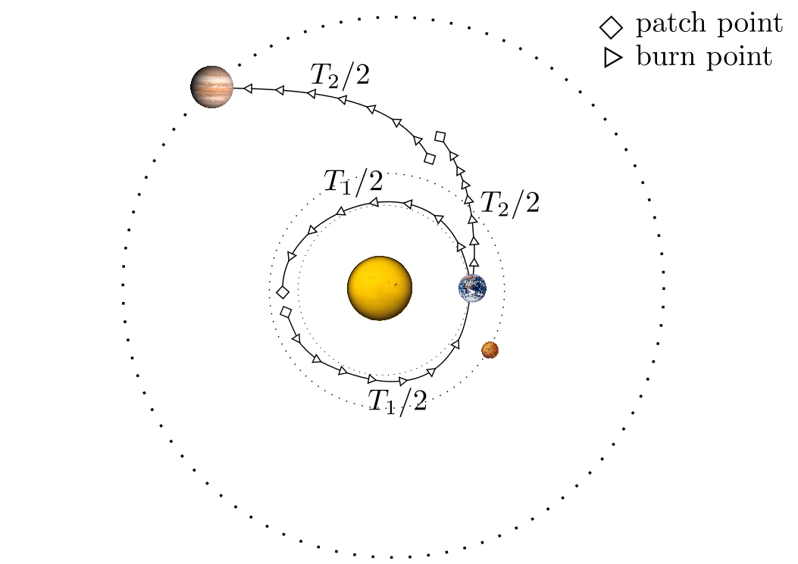
Low-Thrust Modeling in EMTG Transcription
Break mission into phases. Each phase starts and ends at a body.
Sims-Flanagan Transcription
Break phases into time steps
Insert a small impulse in the center of each time step, with bounded magnitude
Optimizer Chooses:
Launch date
For each phase:
Initial velocity vector
Flight time
Thrust-impulse vector at each time step
Mass at the end of the phase
Terminal velocity vector
Assume two-body force model; propagate by solving Kepler’s problem
Propagate forward and backward from phase endpoints to a “match point”
Enforce nonlinear state continuity constraints at match point
Enforce nonlinear velocity magnitude and altitude constraints at flyby
J. Englander, D. Ellison, and B.Conway, “Global Optimization of Low-Thrust, Multiple-Flyby Trajectories at Medium and Medium-High Fidelity,” AAS Space Flight Mechanics Meeting, Santa Fe, NM, January 2014.

Slide 20
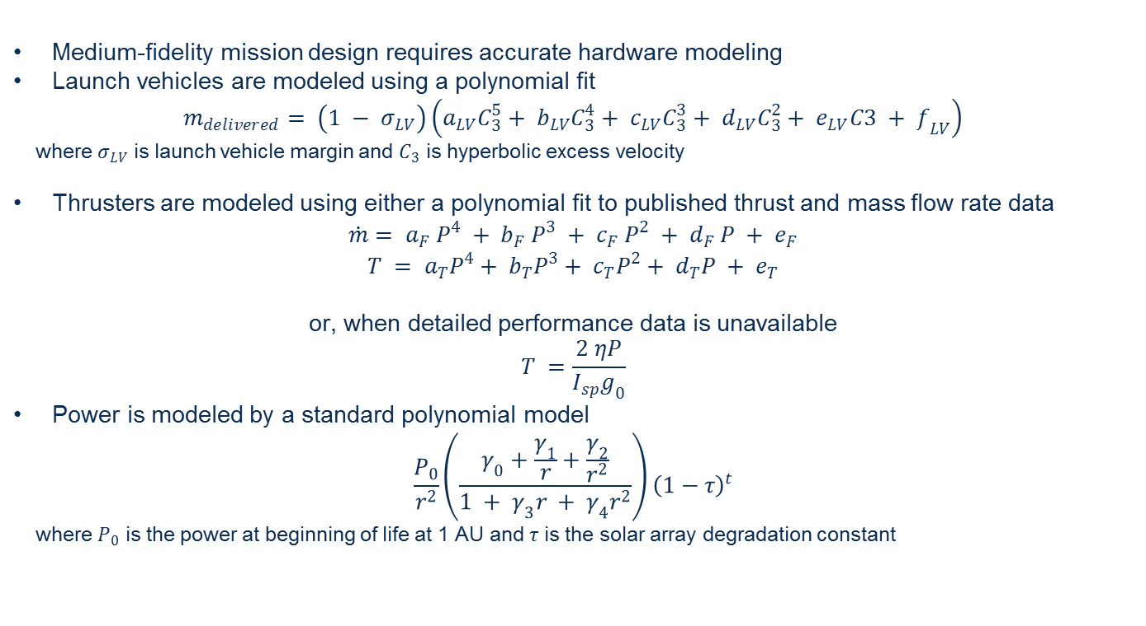
Low-Thrust Modeling in EMTG Spacecraft and Launch Vehicle Models
Medium-fidelity mission design requires accurate hardware modeling
Launch vehicles are modeled using a polynomial fit
$$m_{delivered}= \left.\left(1 − σ_{LV}\right.\right)\left.\left(a_{LV}C_{3}^{5}+ b_{LV}C_{3}^{4}+ c_{LV}C_{3}^{3}+ d_{LV}C_{3}^{2}+ e_{LV}C3 + f_{LV}\right.\right)$$
where $σ_{LV}$ is launch vehicle margin and $C_{3}$ is hyperbolic excess velocity
Thrusters are modeled using either a polynomial fit to published thrust and mass flow rate data
$$\dot{m}= a_{F} P^{4} + b_{F} P^{3} + c_{F} P^{2} + d_{F} P + e_{F}$$
$$T = a_{T}P^{4}+ b_{T}P^{3}+ c_{T}P^{2}+ d_{T}P + e_{T}$$
or, when detailed performance data is unavailable
$$T =\frac{2 ηP}{I_{sp}g_{0}}$$
Power is modeled by a standard polynomial model
$$\left.\frac{P_{0}}{r^{2}}\left(\frac{γ_{0}+\frac{γ_{1}}{r}+\frac{γ_{2}}{r^{2}}}{1 + γ_{3}r + γ_{4}r^{2}}\right.\right){\left(1−τ\right)}^{t}$$
where $P_{0}$ is the power at beginning of life at 1 AU and $τ$ is the solar array degradation constant

Slide 21
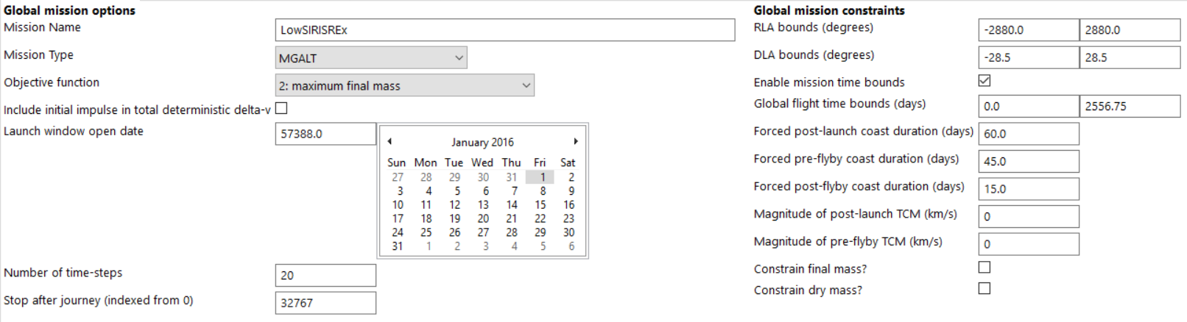
LowSIRIS-REx Step 1: The Global Options Tab
Change the transcription to MGALT
Change the objective function to “maximum final mass”\

Slide 22
LowSIRIS-REx Step 2: The Physics Options Tab
No changes here.

Slide 23
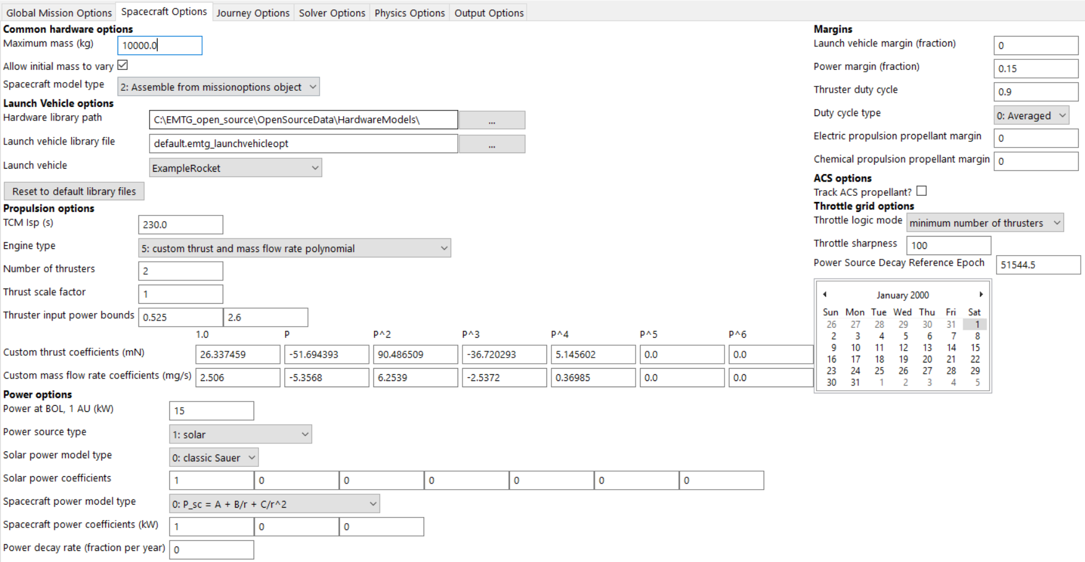
LowSIRIS-REx Step 3: The Spacecraft Options Tab
“Allow intial mass to vary” means that EMTG is allowed to use less initial mass than the launcher can throw if that results in a higher final mass.
The choice of propulsion and power model drastically affects the solution.
The real challenge in designing low-thrust missions is understanding the appropriate spacecraft propulsion and power choices. This is more difficult than learning EMTG.
In this example we apply a 90% duty cycle, 10% propellant margin, and 15% power margin which are standard for NASA preliminary design.

Slide 24
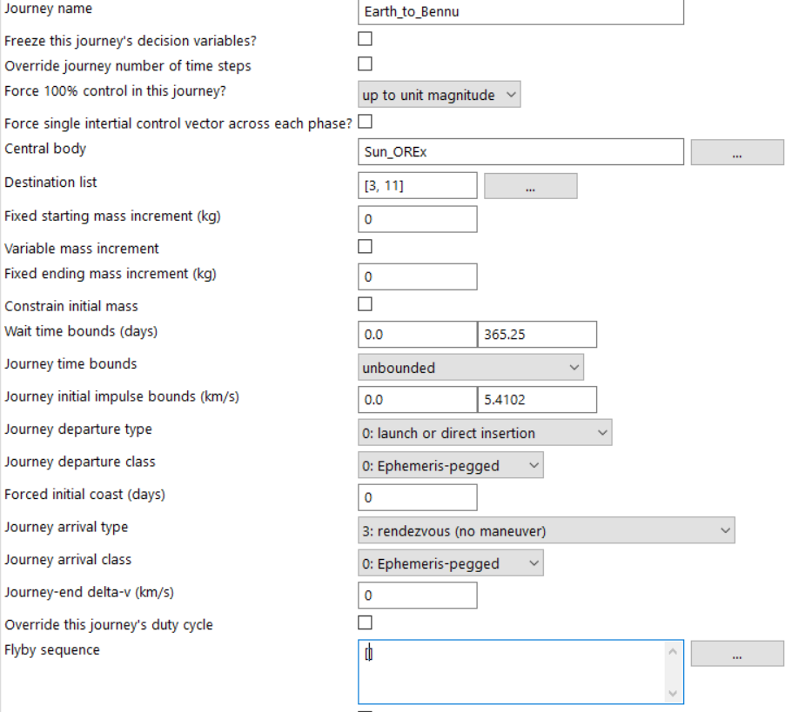
LowSIRIS-REx Step 4a: The Journey Options Tab
Change the arrival type from chemical rendezvous to low-thrust rendezvous.
For LowSIRIS-REx, an Earth flyby is not optimal and so this is a direct mission.

Slide 25
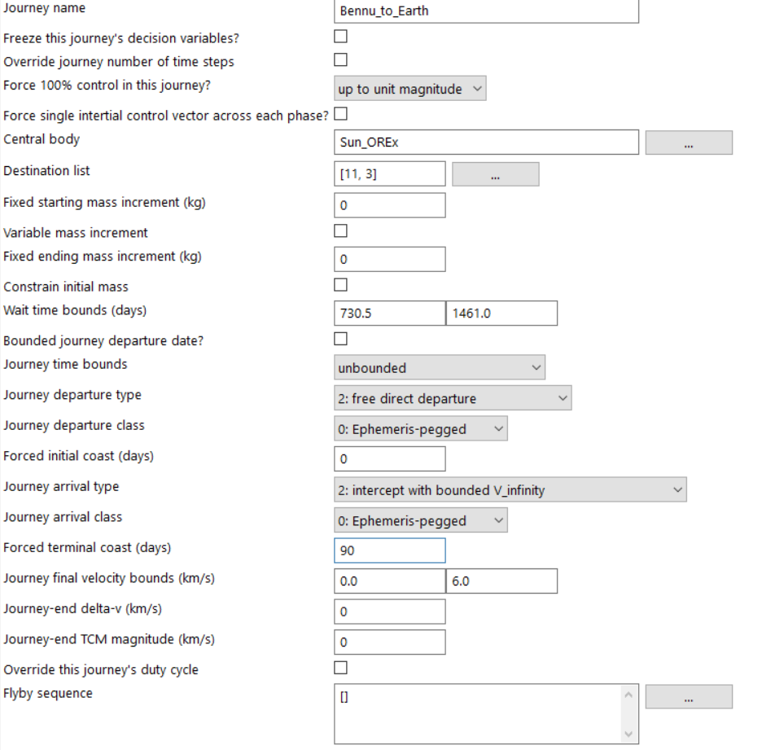
LowSIRIS-REx Step 4b: The Journey Options Tab
Change departure type to “free direct departure,” which means that the spacecraft starts with the position and velocity of Bennu and no initial impulse.
A forced coast of 90 days is inserted prior to Earth return. The spacecraft can make small adjustments using chemical thrusters during that time but the electric propulsion system will not be used.

Slide 26
LowSIRIS-REx Step 5: The Solver Options Tab
No changes here.
You may want to increase maximum run time if you don’t get a good answer quickly.

Slide 27
LowSIRIS-REx Step 6 The Output Options Tab
No changes here.

Slide 28
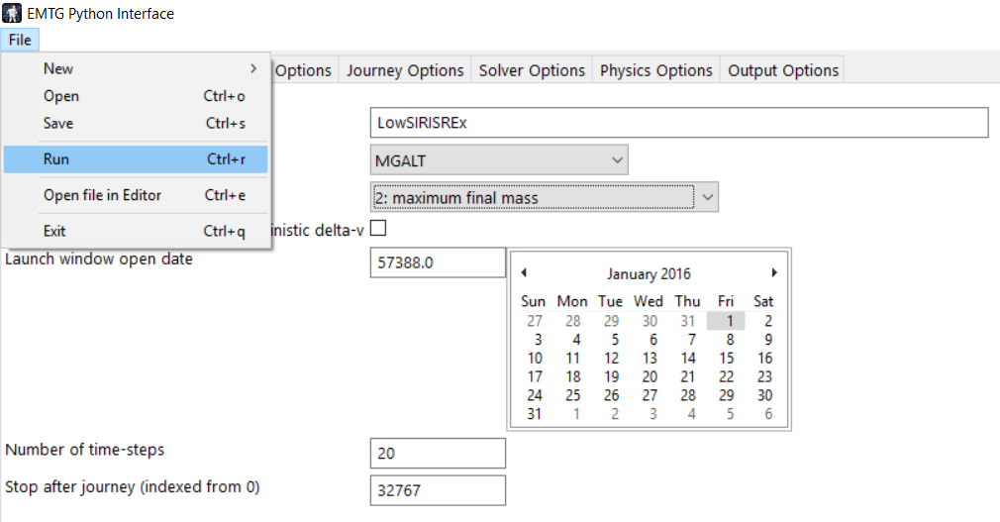
LowSIRIS-REx Step 7: Run your mission!

Slide 29
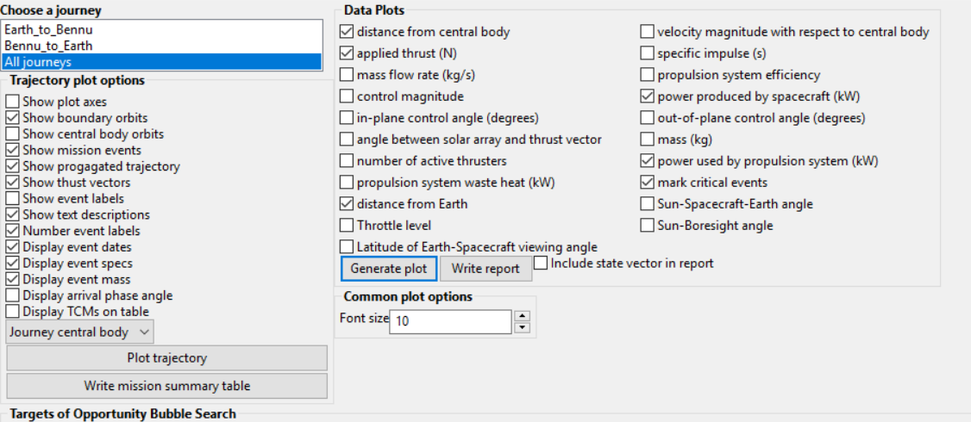
LowSIRIS-REx Step 8: Post-Process Your Mission
In addition to trajectory plots, PyEMTG can create plots of systems parameters, such as power, propulsion, and distance from the Sun and Earth.
Plotting distance from the Earth requires installing the “jplephem” and “de423” Python packages.
PyEMTG can also map the continuous low-thrust model to a discrete throttle table if you have one. Unfortunately we can’t distribute those.

Slide 30
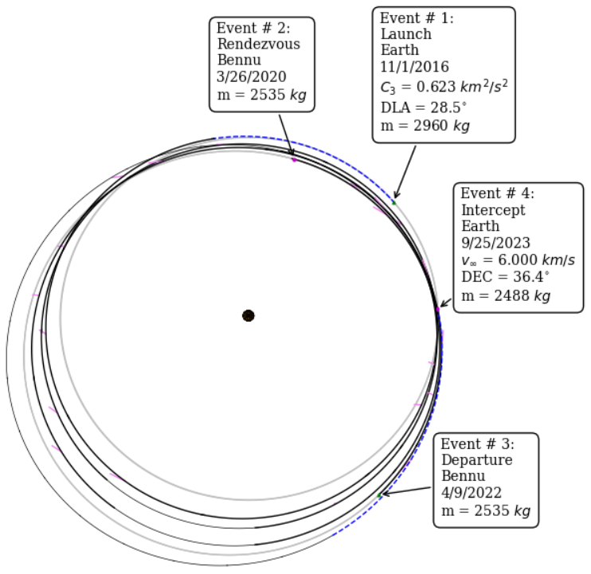
LowSIRIS-REx Trajectory Plot

Slide 31
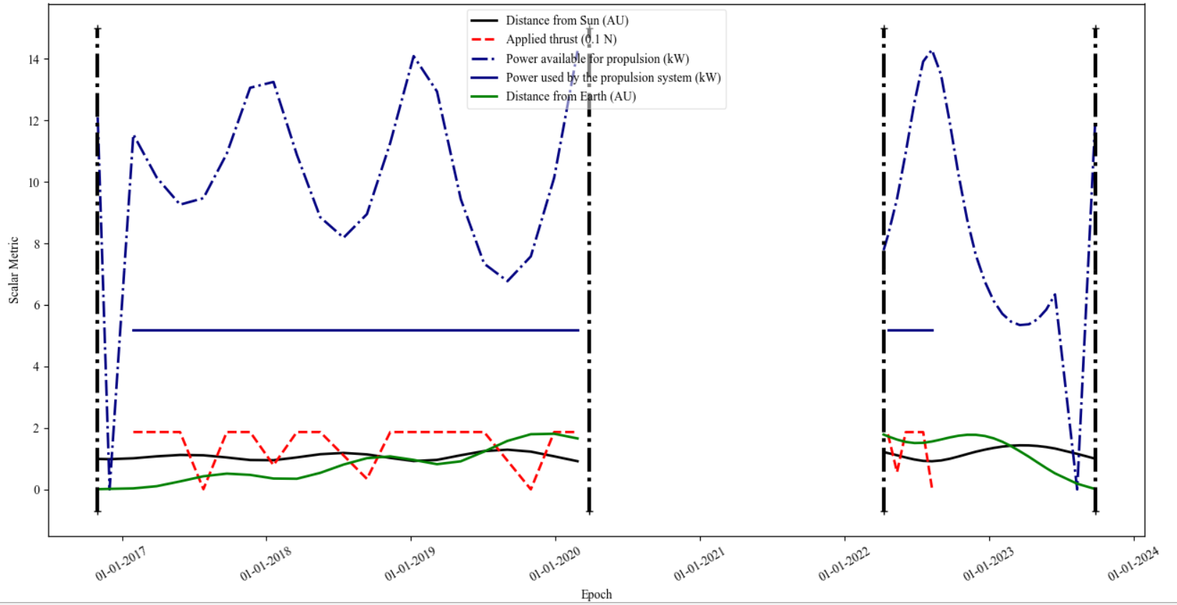
LowSIRIS-REx Systems Plot

Slide 32
LowSIRIS-REx in Medium-High Fidelity
The MGALT transcription is not adequate for detailed design work because it approximates the true low-thrust trajectory with a sequence of conic arcs and bounded impulses
For a more accurate representation of the trajectory, we migrate to the “Finite-Burn Low-Thrust” (FBLT) transcription which uses a numerical integrator and the true low-thrust equations of motion
FBLT can support perturbing terms like third body gravity and solar radiation pressure (SRP)
However the body encounters are still patched-conic
EMTG does support fully integrated gravity assists, orbit insertion, escape, etc., but these are outside the scope of this tutorial.
J. Englander, D. Ellison, and B.Conway, “Global Optimization of Low-Thrust, Multiple-Flyby Trajectories at Medium and Medium-High Fidelity,” AAS Space Flight Mechanics Meeting, Santa Fe, NM, January 2014.

Slide 33
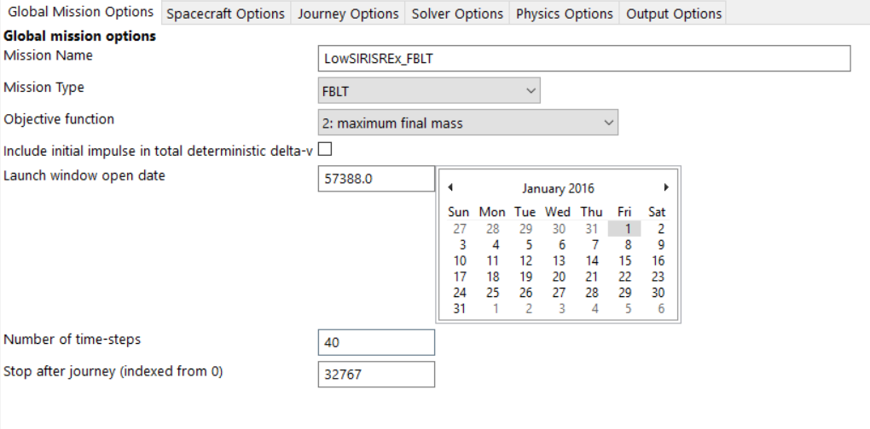
LowSIRIS-REx in Medium-High Fidelity Step 1: The Global Options Panel
Change the transcription to FBLT
We want our detailed trajectory in higher resolution, i.e. more opportunities to change the control, so increase the number of time-steps to 40. EMTG will automatically interpolate the initial guess.

Slide 34
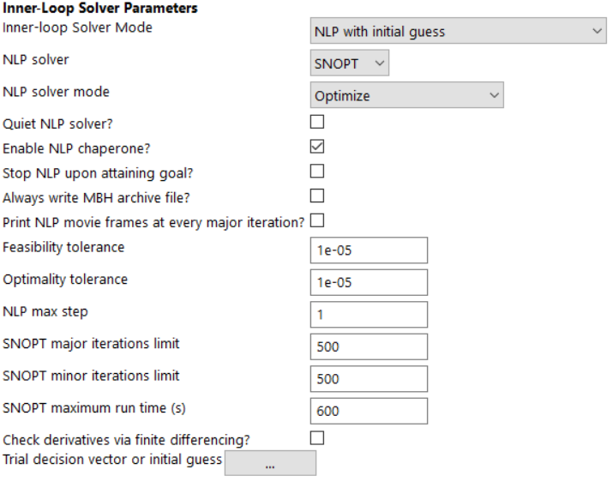
LowSIRIS-REx in Medium-High Fidelity Step 2: The Solver Options Panel
Since we already have a solution in MGALT, we do not need to run MBH.
Instead we will run our NLP solver (SNOPT) directly with the previous solution as an initial guess.
Turn off quiet mode so that you can see SNOPT iterate.
We can tell EMTG to seed from a previous solution by clicking “…” and selecting the previous .emtg results file. PyEMTG automatically converts your initial guess from MGALT to FBLT.
FBLT is very slow. Let’s give SNOPT 10 minutes to chew on the problem.

Slide 35
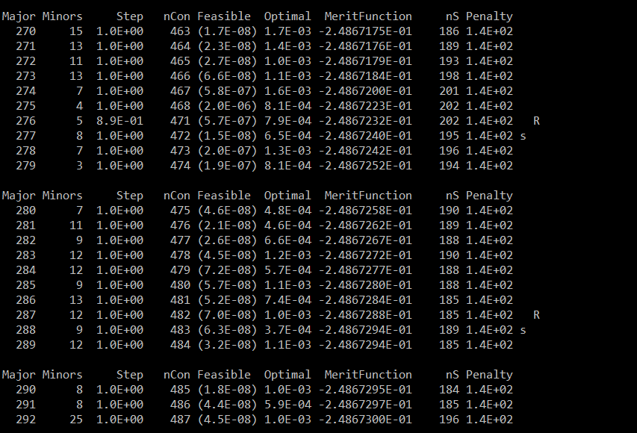
SNOPT is an exciting spectator sport…

Slide 36
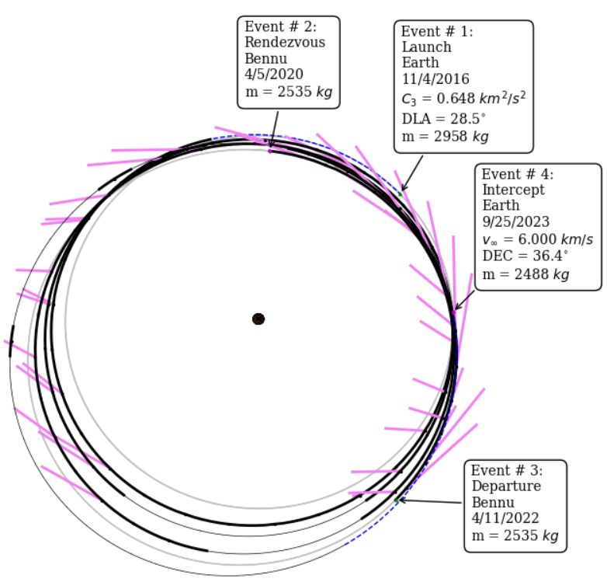
LowSIRIS-REx in Medium-High Fidelity Trajectory Plot

Slide 37
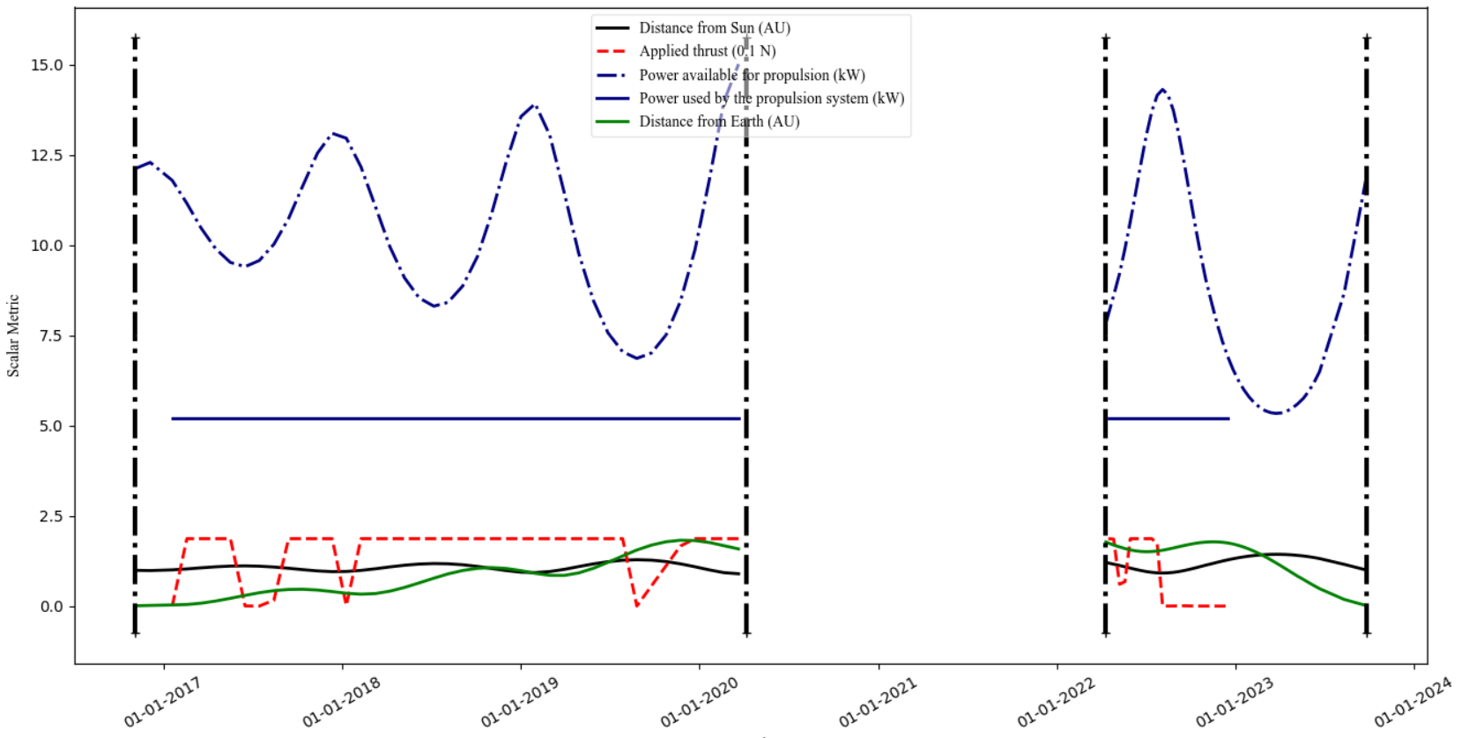
LowSIRIS-REx in Medium-High Fidelity Systems Plot

Slide 38
Some of the many things that we did not cover…
Operational constraints (found in the scripted constraints document)
Distance from the sun and other bodies
Visibility angles at arrival and departure
Powered gravity assist
Low-thrust departure and arrival spirals
Non-body boundary conditions
Central bodies other than the sun (EMTG is central body agnostic)
Sphere of influence patching
Maneuver and target spec files
Ephemeris writer
Hardware libraries (power/propulsion/launch vehicle)
Configuration controlled spacecraft files
Python scripting

